Slide 1
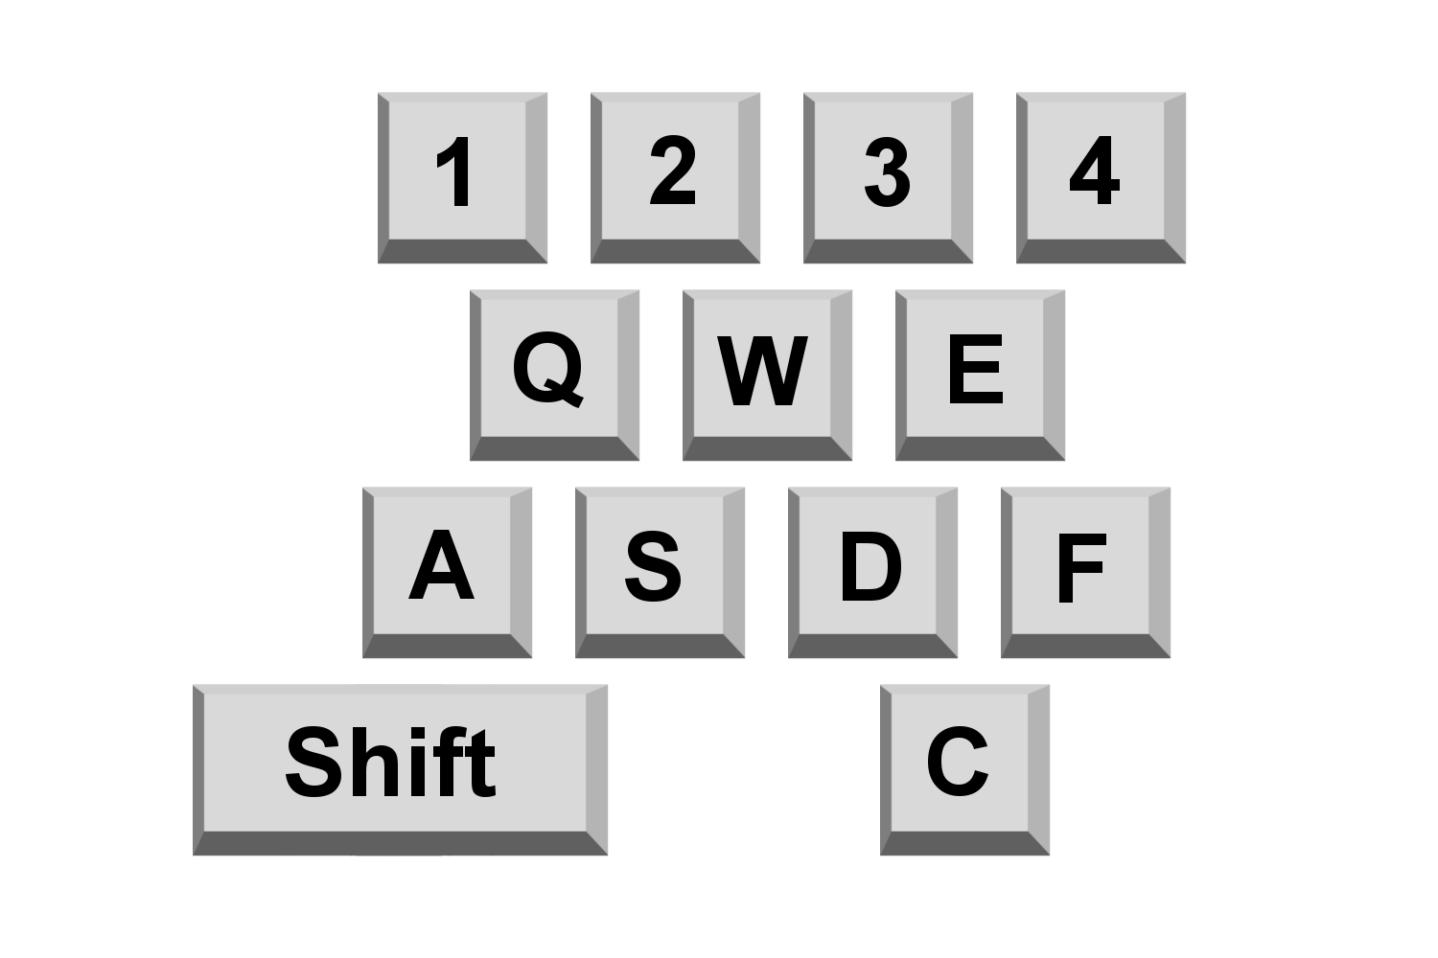
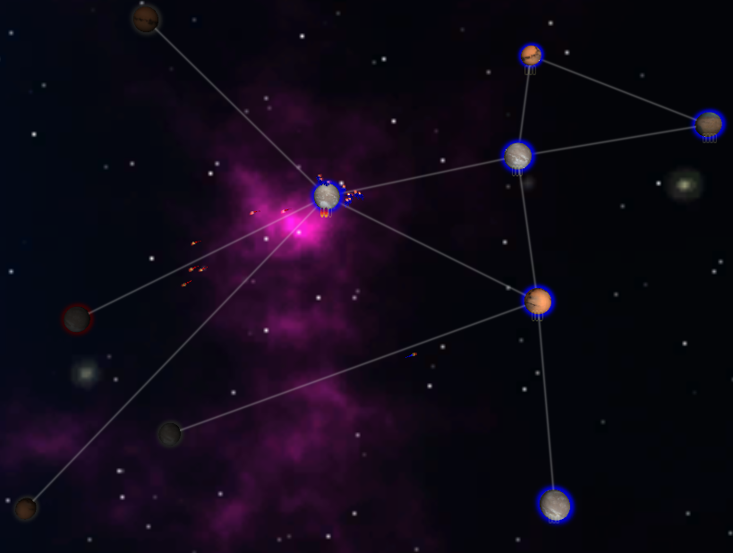
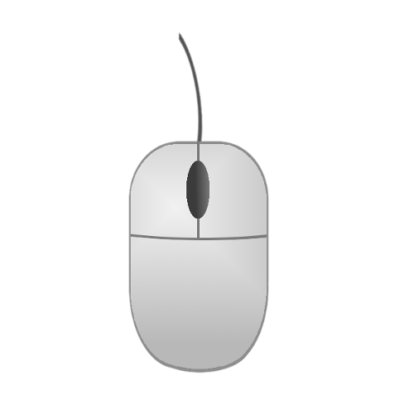
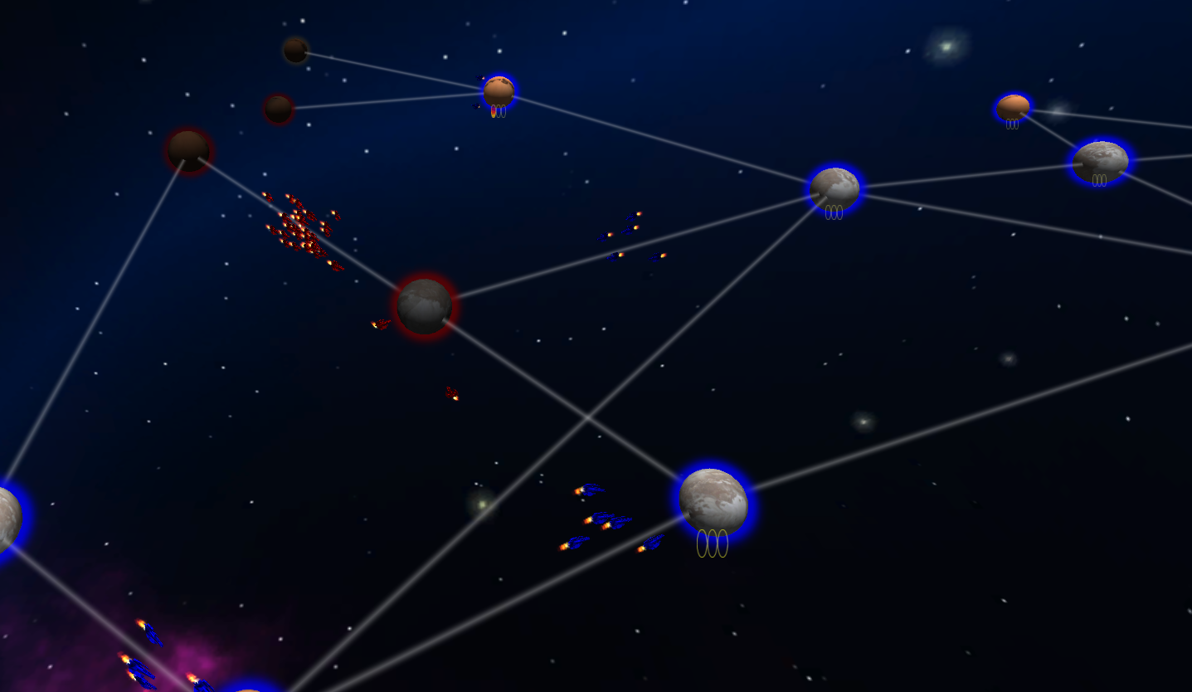
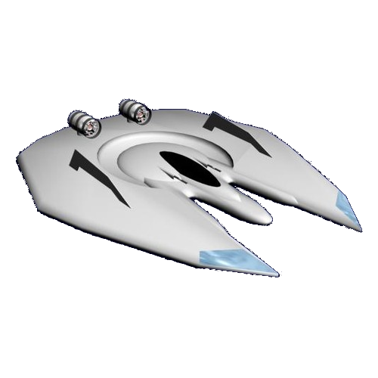
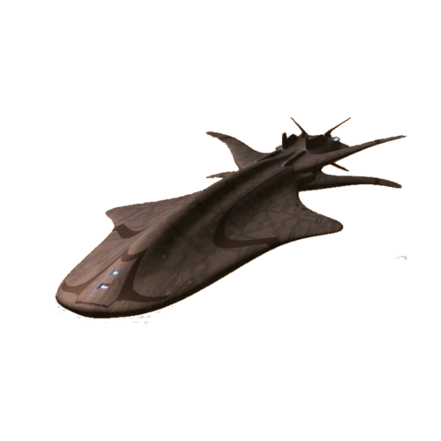
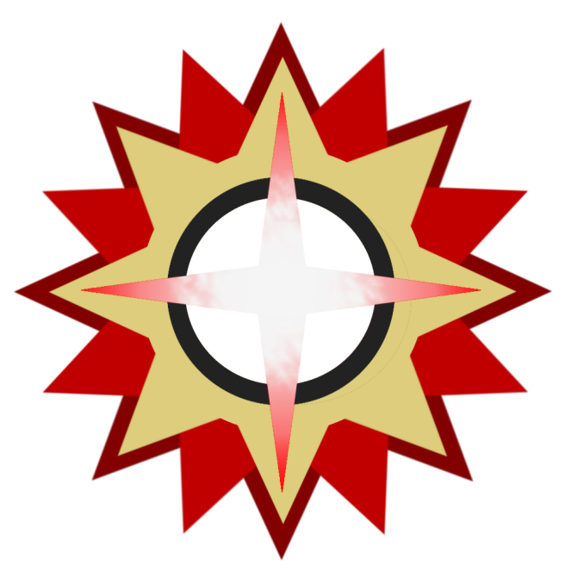
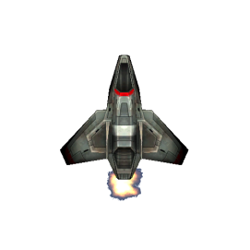
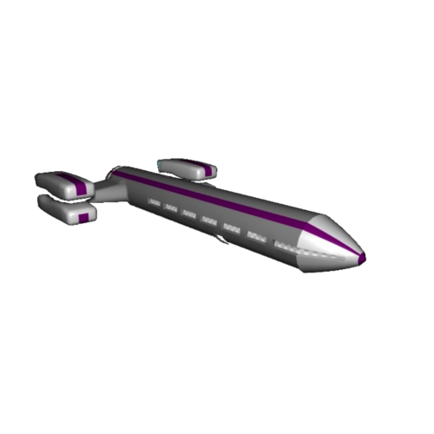
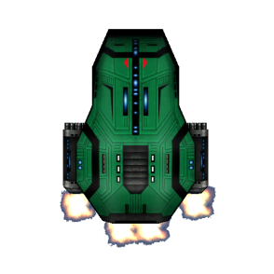
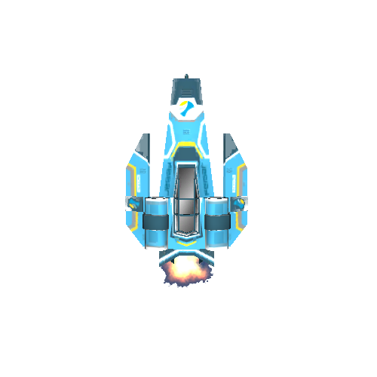
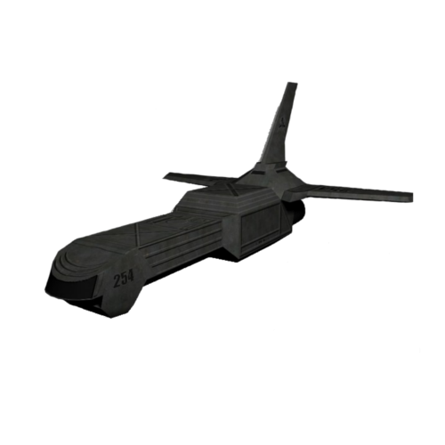
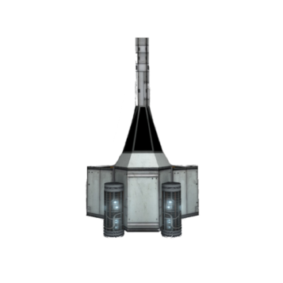
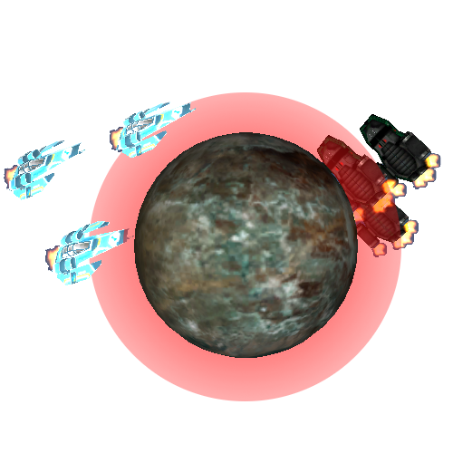
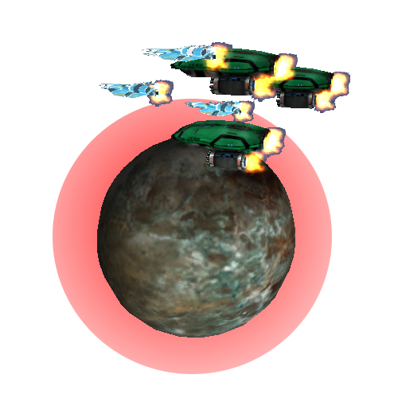
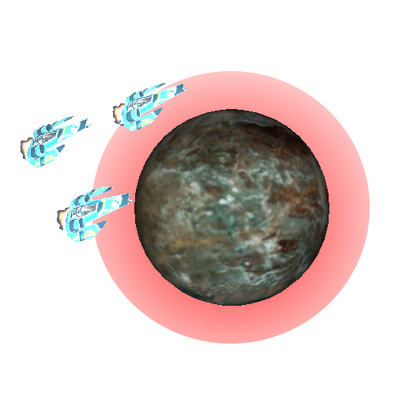
GAME PLAY
Camera Modes
Tactical Mode
Pans along plane on which planets lie.
Rotates in place.
Zooms toward mouse pointer.
Suited for making tactical decisions.
Cinematic Mode
Pans along plane on which planets lie.
Rotates around mouse pointer.
Zooms toward mouse pointer.
Suited for enjoying the view.
FLAG SHIPS
Ships
Scout:
A fragile ship adept at scanning local systems to reveal neutral and enemy planet activity. Scouts increase the vision range of a fleet.
Bato:
This Bomber class vessel is weak in ship combat, but punishing when conquering planets.
Sabre:
A small and maneuverable ship, the Sabre excels against the Lacuna
Vastus:
A destroyer class warship, the Vastus was designed to swat smaller fighter classes like the Sabre. However, its size makes it an apt target for high impact projectiles.
Lacuna:
This wasp-like ship is equipped with high mass torpedoes designed to penetrate the armor of the immense vastus
Fleets may fill a planetary fleet slot. This is useful for defending a key planet, or preparing for a large scale attack.
Fleets filling a planetary fleet slot are able to merge with other fleets standing on the same planet. This can be useful for conserving vital fleet slots and making balanced fleets that are hard to counter.
Notes:
Left – Game Play

Slide 2
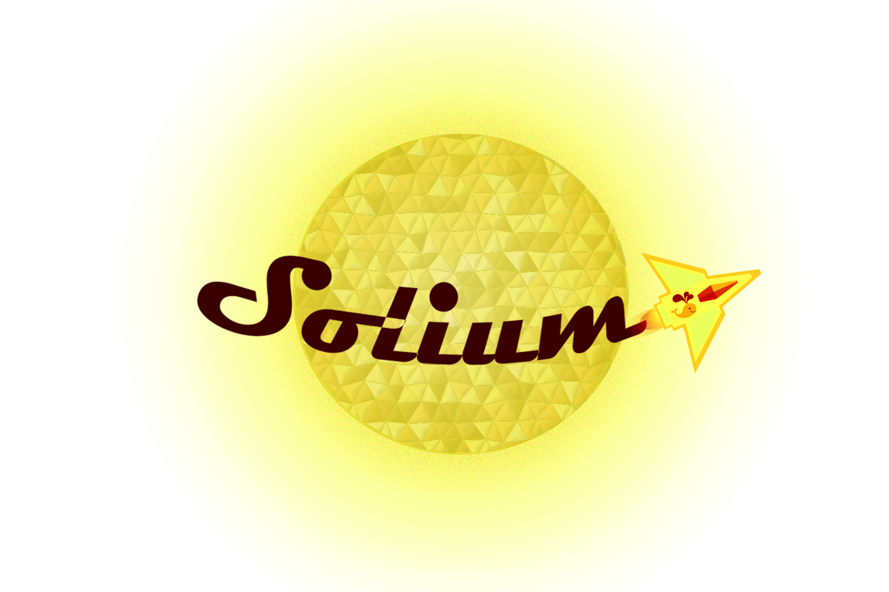
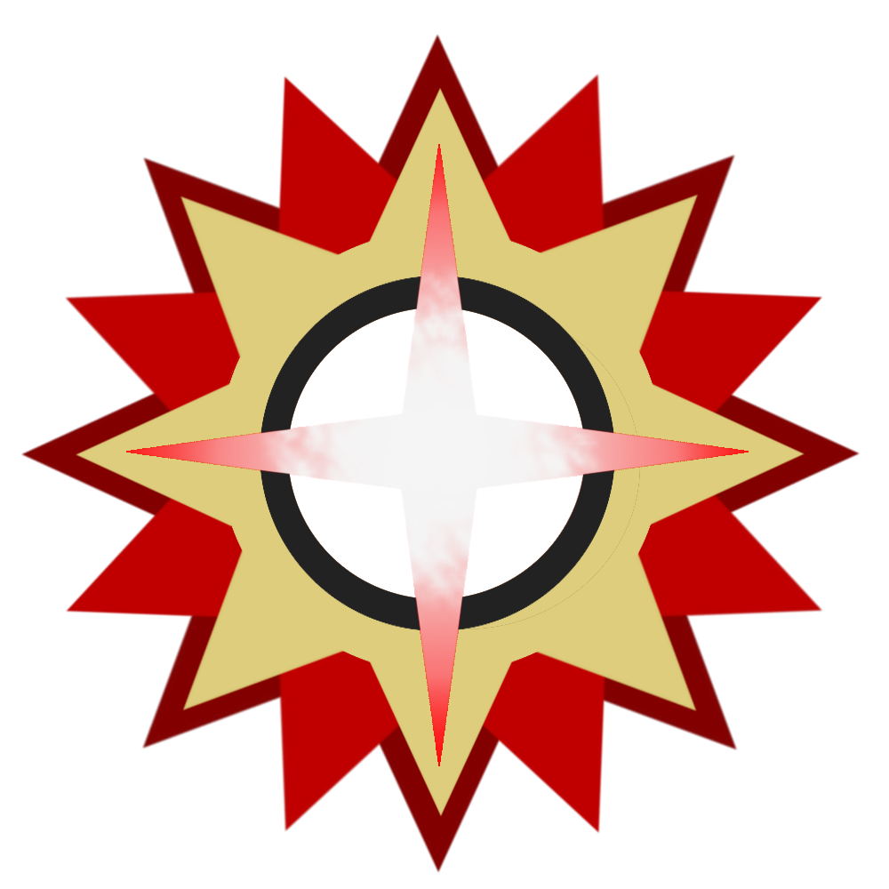
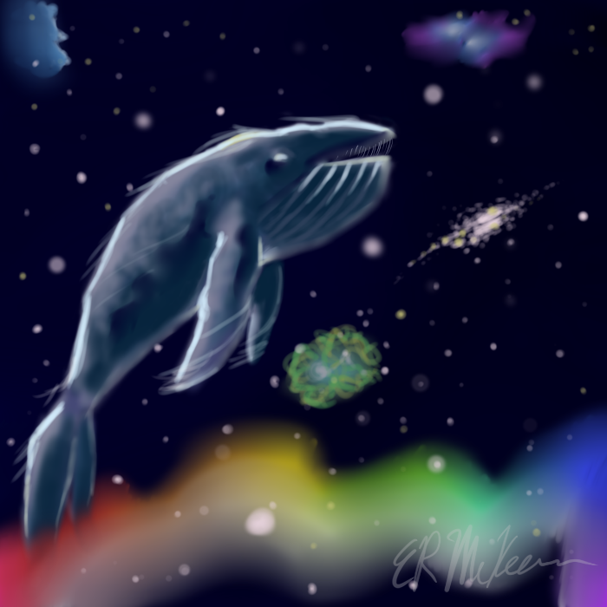
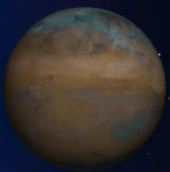
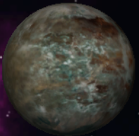
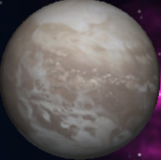
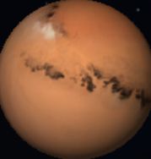
A competitive, node-based real time strategy game
(featuring republicans, barbarians, and beliebers)
SETTING
SUMMARY
You have been selected as the new commander of your regime (see: Races). To raise the spirits of your people, you have begun a campaign to explore new worlds in search of riches and for the pursuit of glory. However, other races are expanding, threatening your campaign. With the overwhelming support of your people, you have declared total war to enforce the peace of the solar system by eliminating all those that would oppose your will.
Solium is a node-based real time strategy game. You are the commander of an advanced civilization, whom seeks to control all planets in the Space Whale Nebula. To accomplish this goal, the player must expand to new planets, harvesting advanced resources along the way. However, other civilizations also seek to expand, impeding your primary goal: total planetary control. Thus, you must choose between enhancing resource harvesting, advancing planetary defenses, or constructing a massive fleet to strategically outmaneuver the opposing factions.
THE RACES
Conquer as three unique factions, each with their own kickass flagship. Listen to each race story to determine their unique play-style.
The Galatic Republic of Crixus
Built on the pillars of free speech, science, and industry, the Republic seeks to civilize all barbaric civilizations, especially the relentless Gilgamecs.
You have been elected by the elders as the supreme commander of the Galatic fleet. Your first assignment is to tame, eradicate,the Gilgamecs.
The Gilgamecs
A barbaric civilization, the Gilgamecs demand bloodshed in honor of their god Gilga.
You, the new warlord of the Gilga, slew the mighty Gorenack the Beast and assumed the skull throne. In an attempt to hold together the volatile tribes, you promise glorious victory.
The Beliebers
An ever expanding race, the Beliebers have overpopulated your home world, siring thousands of new Beliebers.
You, Justin the Harmonious, the most potent of the cult, have been chosen to populate uncharted worlds aboard the dreadnought The Babymaker.
THE SOLIUM
Home
Unique bonuses by race
Solium takes place in the Space Whale Nebula, named after team mascot: Winston the Walrus-wearing whale
Atop your glorious throne, you peer over the galaxy map, carefully dictating every action of your people. You alone decide which planets to explore. Will you quickly unveil the fog of war? Or will you fortify all that you have for dear life? Choose your strategy wisely as your enemies are primed to fight until the bitter end.
CREATED BY
Garden
Supports population growth
Brett Dickson
Jason Flanders
Chelsey Salberg
Noah Torrance
Steven Vignos
Ice
Supports ship building
Desert
Supports building construction
Notes:
Middle -Lore

Slide 3
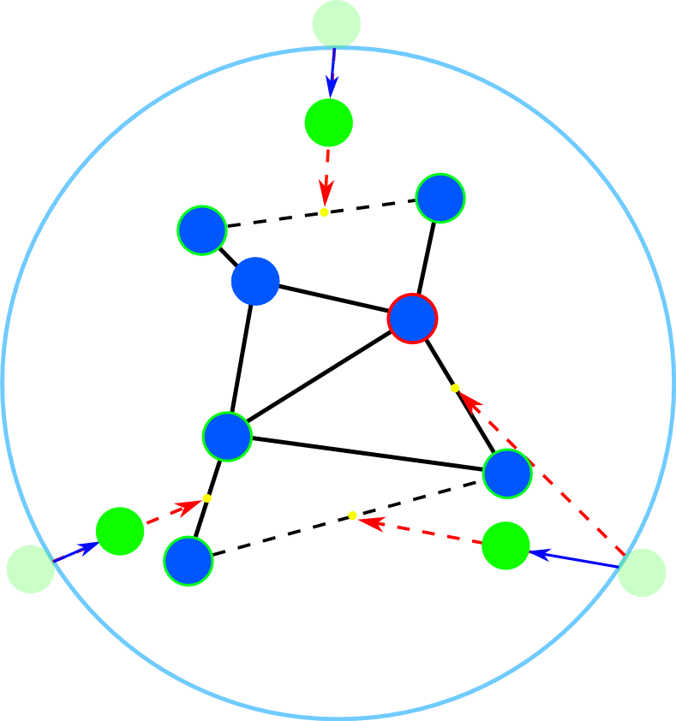
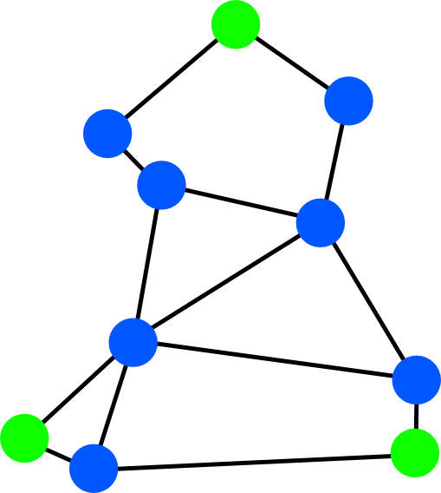
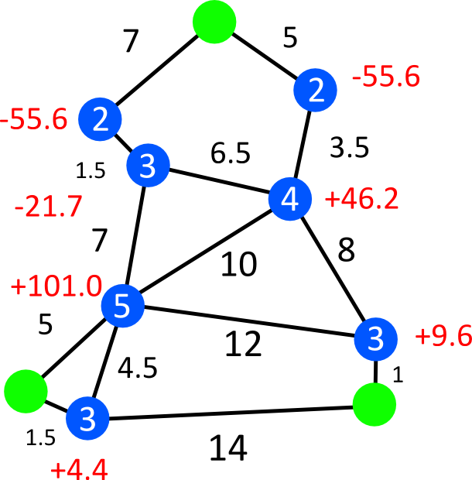
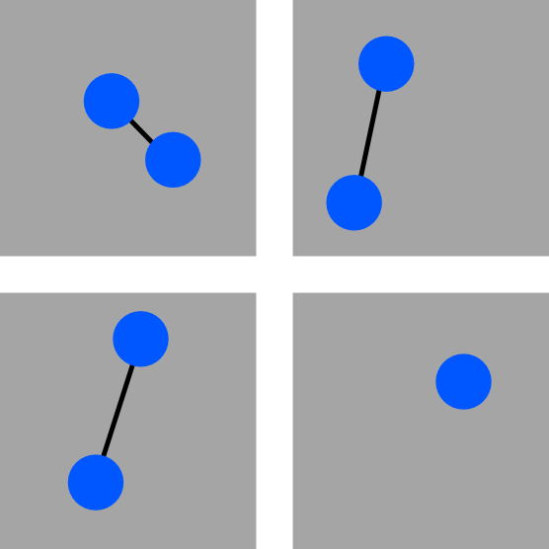
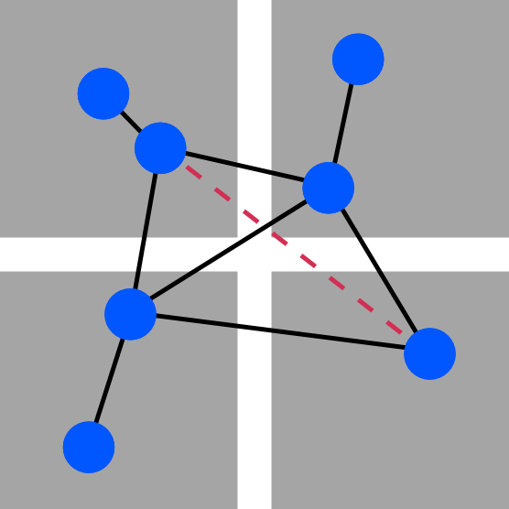
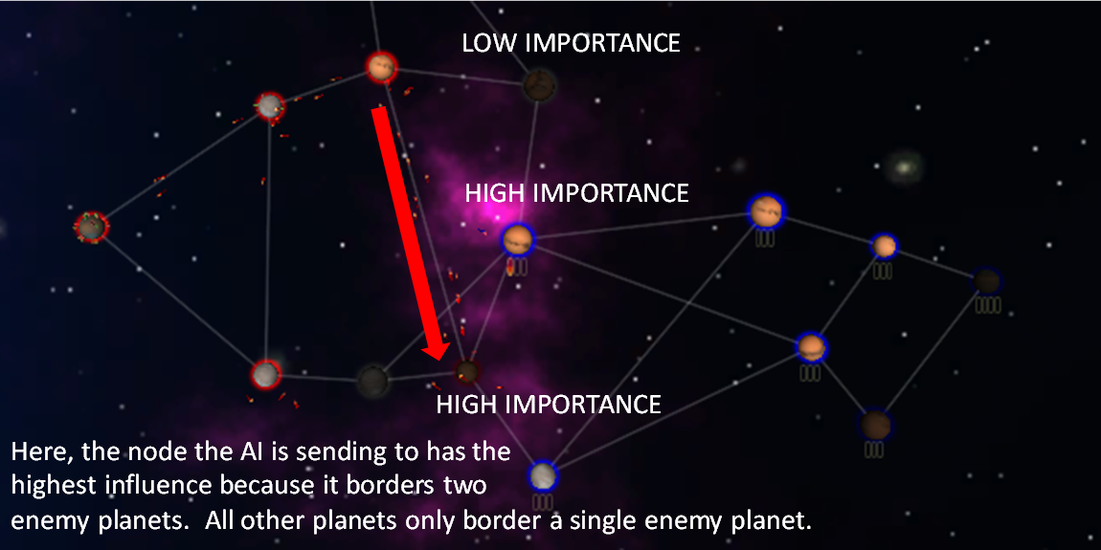
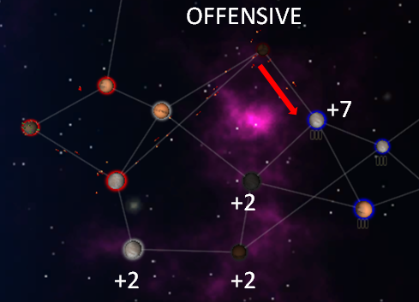
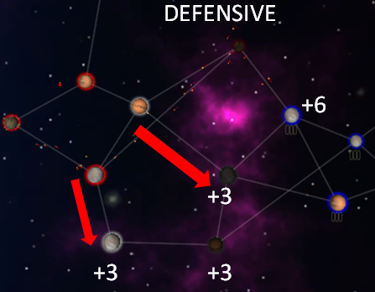
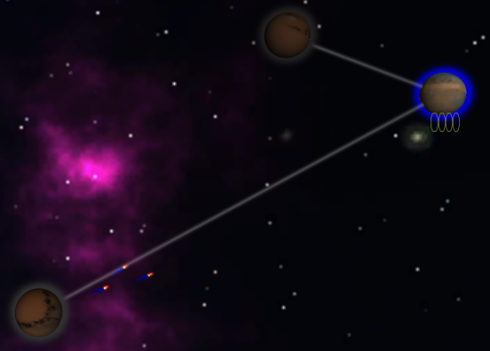
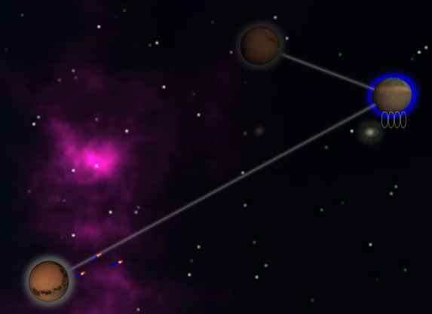
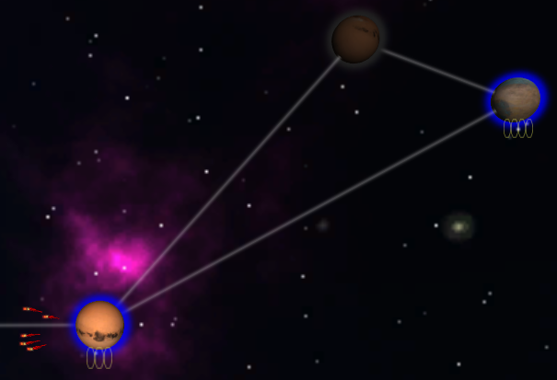
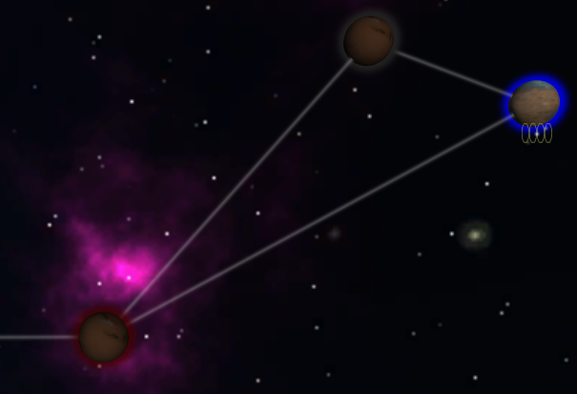
TECHNICAL
Map Generation Algorithm
Place Sectors and Planets
Connect Sectors
Place Home Planets
Connect Home Planets
Assign Bonus Resources
Ray cast from home planet to midpoint intersects a planet. So don’t connect with red-bordered planet.
2 : Degree
7 : Distance
-4.4 : Bonus
Average Distance: 6.1
Average Degree: 3.14
Base Resources: X = 100
Distance between planets is too great.
So don’t connect.
Initial Home Planet Position
Bonus Max Resources = X – X*(avg degree/ degree) * (avg adjacent distance/ avg distance)
Sectors are place in a grid. The number of sectors is equal to the ceiling of half the number of planets.
Planets are placed in connected pairs in each sector.
If there are an odd number of planets, one of the sectors will have only one planet.
The closest planets between 2 adjacent sectors are connected with an edge.
Diagonally adjacent sectors are only connected if the 2 closest planets between them are within a set distance proportional to the size of the map.
Home planets are placed circularly around the map.
While the path from the home planet to the midpoint of the 2 closest planets intersects a planet, the farther of the 2 is replaced with the next closest planet.
The home planet is then moved closer towards the midpoint of the 2 chosen planets proportionally to the size of the map.
The home planets are connected to the planets chosen in the previous step.
The result is a map in which the planets do not overlap, edges do not intersect planets except at their end points. The resulting map can be described as a strongly connected graph where the degree of the vertices (the planets) is at least 1 and at most 8.
A maximum resource value is assigned to each planet. A bonus to the maximum resource value is calculated after placing and connecting the planets.
The bonus value assigned to a planet is proportional to the number of planets it connects to, and proportional to the average distance to the planets it connects to.
Home planets have no map-based bonuses.
Templates
Artificial Intelligence: Influence Maps
The AI also can be instructed via the pregame lobby to behave differently, whether it’s offensive, defensive, or rapid expansion. This can be achieved through setting the influence values based on what behavior the user chooses. For example, the influence value for a reachable enemy planet on a defensive template is +3 whereas a reachable enemy on an offensive template is +7. So, when the AI makes a decision, it is more likely it will send units (and thus attacking) the enemy when its template is offensive.
Influence mapping is a model for artificial intelligence systems to make accurate decisions based on the current state of the perceived world. Here, influence maps track the state of game by considering all the planets and how they relate to the AI’s controlled planets. There are many different factors that contribute to influence values, such as connectivity of the examined planet and even further, who controls said surrounding planets.
The AI makes a decision based on nodes with the highest influence values. Naturally, since a player cannot send units to a planet that is not directly connected to a planet that that player owns, the AI does not take into account these planets. This also makes the AI not omniscient by implementing a “fog of war” type of effect for the AI.
Networking
Fog of War System
When the multiplayer game scene is loaded, each client (including that local to the host) is instantiated with a PlayerController and GUI, which fires events (either remotely or locally) to the server through Remote Procedure Calls (RPCs). These RPCs are used during the creation of game objects and the changing of game elements to synchronize the scene for all players.
Different color states are linearly interpolated between to enable fading in/out of objects.
To enable multiple transparent objects to overlap while keeping depth information, a custom shader was written for planets.
To allow the halo effect around the planets to have a dynamically modifiable tint while maintaining transparency and continuing to ignore lighting, a custom shader was written for halos.
The Fog of War system uses Unity’s layer Culling Mask system to only render certain layers. Visible and invisible layers are defined so that unknown and unobserved planets or fleets can be prevented from being rendered. Semi-visibility is achieved through color adjustment
Player owned planets and fleets have triggers that increase visibility of objects that intersect with the trigger colliders.
Not owned and invisible
Owned and Fully Visible
Not owned but adjacent to owned, so semi-visible.
Not owned but observed so fully visible.
Trigger radius
Solium is a competitive multiplayer game. As such, networking is a huge technical component to ensure competitive gameplay. Solium is based on an Authoritative Server structure. The each client communicates directly to the server, and the server broadcasts to all clients. Clients are “dumb” in the sense that they do not contain the same logic that the server does for determining game events, however they are still responsible for drawing and moving certain objects within their own scene, maintaining the local GUI and responding to player input by firing remote events to the server.
Fog of War effect in effect.
Semi-Visible and Fully Visible
Observed by Fleet
Captured Planet Now Observes
Lost Planet to Enemy
Notes:
Right - Tech

